Slide 1
Plant Monitoring Robot
Presented by:-
Ankita Panpatil
(Marketing Round)

Slide 2
Outline
Introduction to Social Media Marketing
Social media Ecosystem
Facebook
Linkedin
Social Media Ads

Slide 3
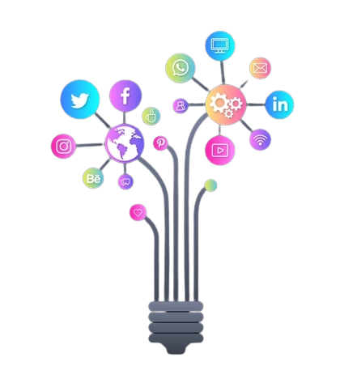
Introduction to Social Media Marketing
What is social media marketing?
What are the benefits of using social media Marketing?
Why is social media marketing important for businesses?
How does a company use social media marketing?
Why do we need social media marketing?
Notes:
Social media marketing is the use of social media platforms to generate customer engagement, build brand awareness, and enhance customer service.
Social media marketing has become the most powerful form of marketing to date. It encompasses a multitude of platforms and is considered the best way to connect with your target audience. Social Media Marketing benefits include: - capturing more customers - communicating with your audience - Increasing brand awareness - Generating leads
. Social media marketing is becoming an important part of the marketing strategy for many businesses. It provides several benefits for businesses such as brand awareness and increased engagement.
. There are a lot of benefits to be gained from social media marketing and it is important for companies to get on the bandwagon, because this type of advertising has a high ROI.
Companies can use social media marketing to reach out to their prospective customers and build a brand. It helps with customer acquisition, content distribution, SEO and other marketing objectives. They can also use it for promotional purposes by promoting products or services or sharing content based on specific interests of consumers.
Linkedln, Twitter, Youtube, Facebook, Instagram, and even some of the younger platforms like TikTok allow marketers to connect and engage potential customers wherever they are.Marketers can engage their audience with a solid social media strategy and the ability to develop compelling content.

Slide 4
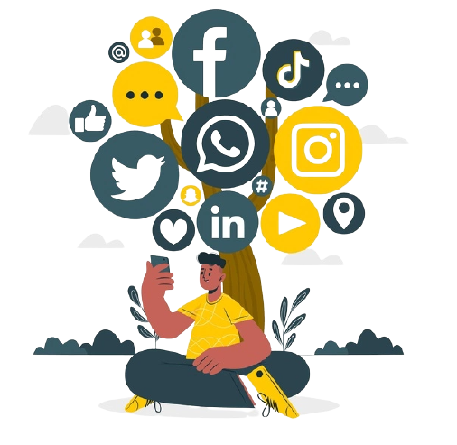
Social media Ecosystem
What is the Social Media Marketing Ecosystem?
Social media marketing is a digital marketing strategy that entails the use of social media platforms to build a brand, engage with customers and increase sales or other revenue.
How many people use social media each day?
Social media is one of the most popular platforms in the society, with over 3.4 billion monthlyactive users. While there are various social networking sites which are used by different people and for various purposes, Facebook is still the most popular and widespread social media network.
Notes:
Social media marketing is a digital marketing strategy that entails the use of social media platforms to build a brand, engage with customers and increase sales or other revenue.
Social media is one of the most popular platforms in the society, with over 3.4 billion monthlyactive users. While there are various social networking sites which are used by different people and for various purposes, Facebook is still the most popular and widespread social media network.

Slide 5
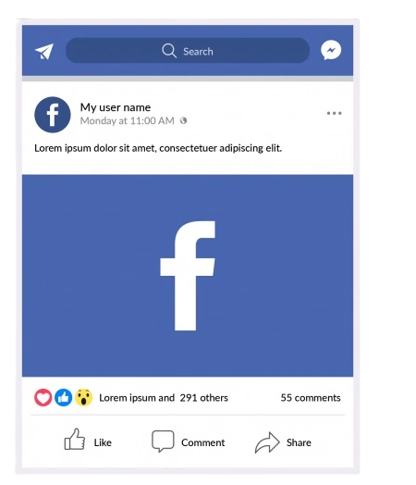
Facebook
What are the benefits of using a Facebook business profile for SMM?
Some benefits of using Facebook for business purpose are - the ability to reach out to potential customers through live chat, advertising on the platform, collecting customer feedback and posting content. Facebook Business Profile can be used as a great opportunity for companies who want to give their customers more personal touch by posting pictures and sharing stories about their personal lives.
What is the difference between FB group and page?
Facebook Pages are a form of business profile for corporations, organisations, and public people on Facebook. Their goal is to establish a connection with their target audience/community. Facebook Groups are designed to bring people together around a shared interest. Their goal is to provide a platform for people to interact with one another.
Notes:
Some benefits of using Facebook for business purpose are - the ability to reach out to potential customers through live chat, advertising on the platform, collecting customer feedback and posting content. Facebook Business Profile can be used as a great opportunity for companies who want to give their customers more personal touch by posting pictures and sharing stories about their personal lives.
Facebook Pages are a form of business profile for corporations, organisations, and public people on Facebook. Their goal is to establish a connection with their target audience/community. Facebook Groups are designed to bring people together around a shared interest. Their goal is to provide a platform for people to interact with one another.

Slide 6
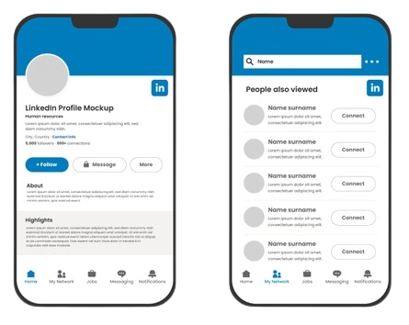
Linkedin
How can you use Linkedin SMM to promote your business?
There are many ways to promote your business on Linkedin. You can use the platform to share and discover content, engage with others, and build relationships with influencers who may be interested in working with you.
What are the benefits of using a Linkedln Business Profile for SMM?
Linkedln is a popular social media platform that most professionals use to build their professional networks. Linkedin profiles can help businesses develop their SNS marketing strategy such as Linkedln advertising and create content for different platforms including blogs, podcasts, and websites.
Notes:
There are many ways to promote your business on Linkedin. You can use the platform to share and discover content, engage with others, and build relationships with influencers who may be interested in working with you.
Linkedln is a popular social media platform that most professionals use to build their professional networks. Linkedin profiles can help businesses develop their SNS marketing strategy such as Linkedln advertising and create content for different platforms including blogs, podcasts, and websites.

Slide 7
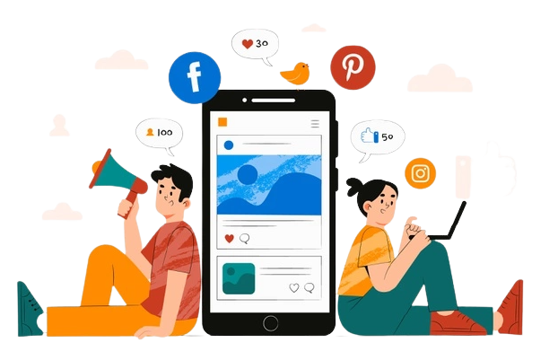
Social Media Ads
What are the benefits of using Facebook Ads for SMM?
What is the difference between a regular Instagram ad
What are the benefits of Youtube Ads for SMM?
What are the benefits of Linkedin Ads for SMM?
Notes:
The benefits of using Facebook ads for SMM are many. These include the fact that it’s easy to create and manage ads with just a few clicks. You can also target your ad to audiences based on location, demographics, interests, and so on.
. Regular lnstagram Ads: An Instagram ad is a simple image that has been created specifically to be shown in an Instagram feed. They are mainly designed to increase brand awareness and generate conversions through advertising.
. SMMAds: These types of ads work with the users’ social media strategy by promoting new posts and content from the company via their Social Media Marketing accounts on platforms like Facebook, Twitter, Linkedln or YouTube. They often require more time
This is an excellent option for small businesses because it allows them to focus on their products and not spend too much money on expensive advertisements. This also doesn’t take away from their time or resources which can be used elsewhere, such as building up the products and services.
Linkedln ads for SMM provides many benefits such as: low cost per click, high engagement, and high click-through rate.

Slide 8
Thank You!!!!!

